Slide 1
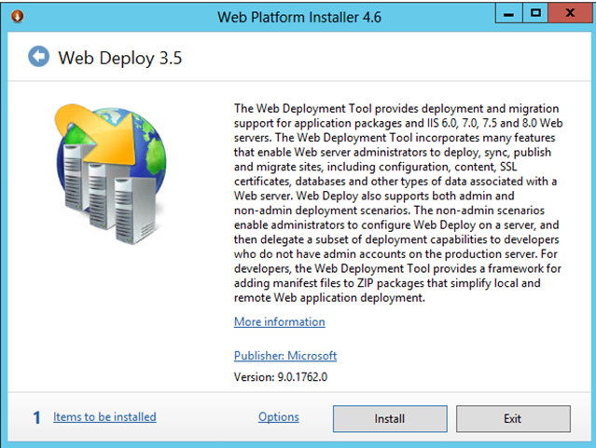
Run the Web platform installer file and click install.

Slide 2
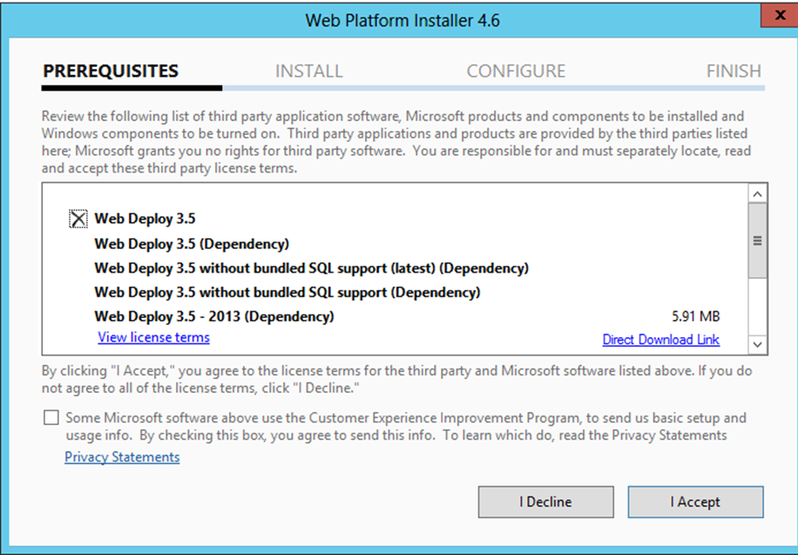
Accept to continue with installation.

Slide 3
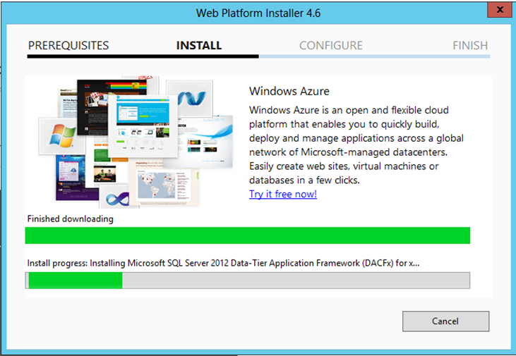
Let the installer continue perform it’s tasks.

Slide 4
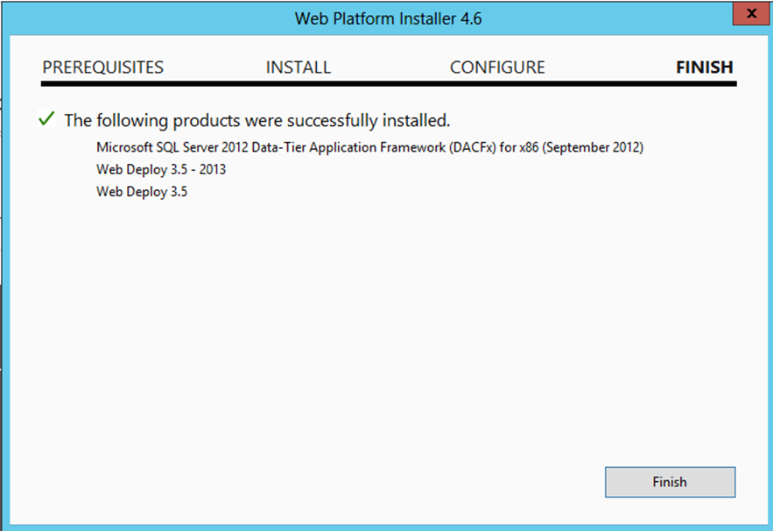
Click Finish after installation

Slide 5
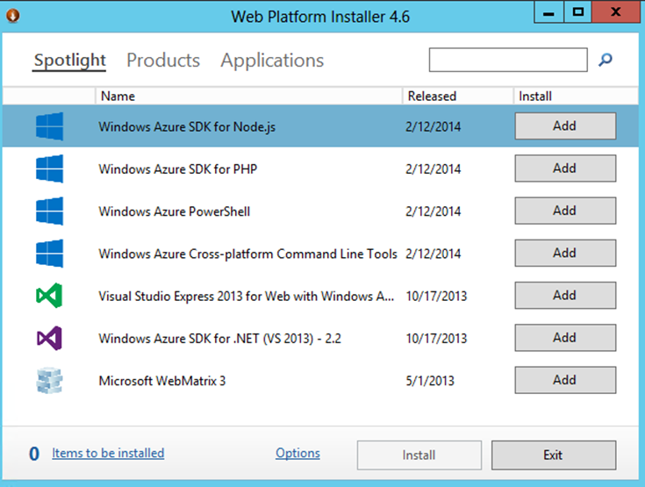
The other items are not needed so once done, just click exit.

Slide 6
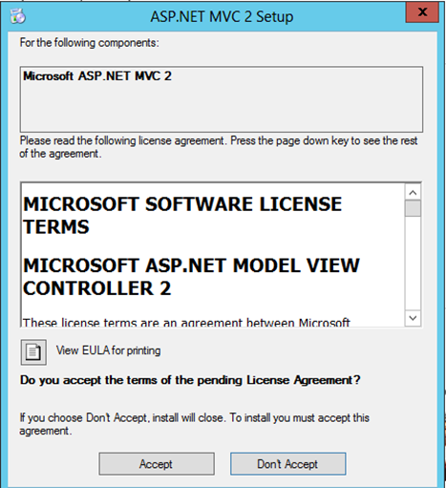
Run the installer file for ASP.NET MVC2 once you download it and click ‘Accept’ to continue.

Slide 7
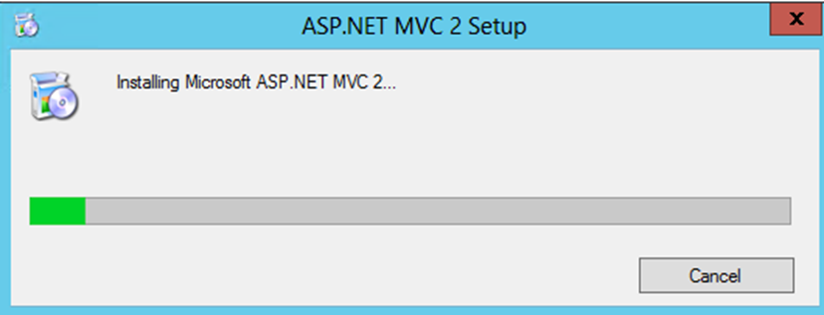
Allow installer to run.

Slide 8
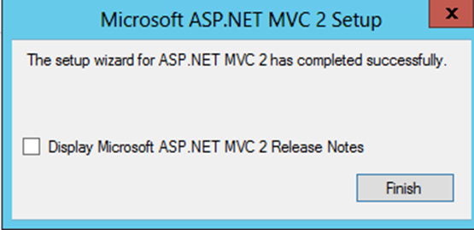
Once installation is complete, click ‘Finish’

Slide 9
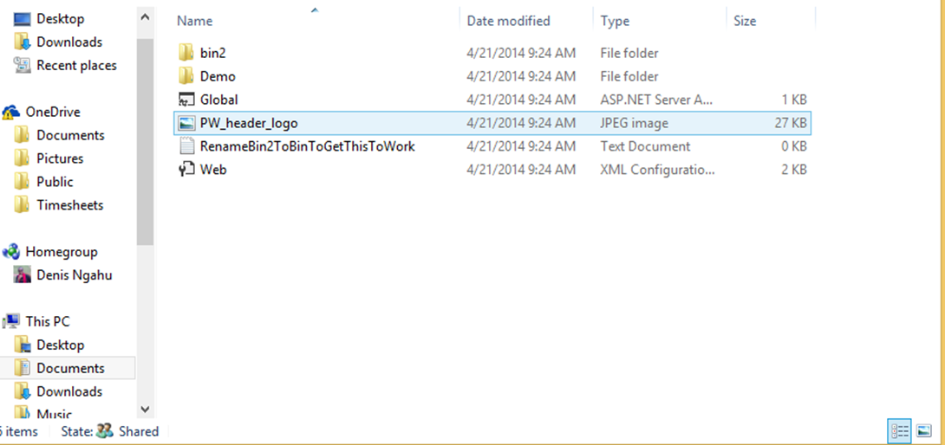
Rename ‘bin2’ folder to ‘bin’

Slide 10
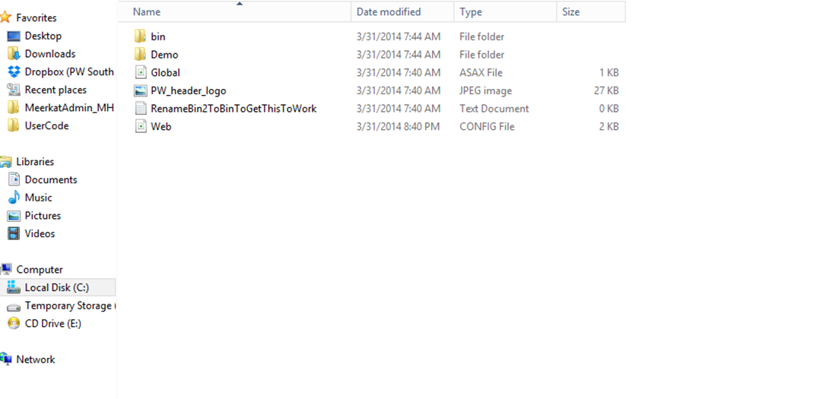
The renamed bin folder

